Slide 1
Expression Language

Slide 2
Action Elements
In this module we will see below topics
Expression Language

Slide 3
Expression Language
Expression language (EL) has been introduced in JSP 2.0. The main focus of EL is to simplify the process of accessing data from bean properties and from implicit objects. EL includes arithmetic, relational and logical operators too.
Syntax of EL:
${expression}
What ever is present inside braces gets evaluated at runtime and being sent to the output stream.
EL predefined variables:
Similar to implicit objects in JSP we have predefined variables in EL. In the above examples we have used param and applicationScope, they are also the part of these variables.
pageScope: It helps in getting the attribute stored in Page scope. pageContext: Same as JSP PageContext object. sessionScope: Fetches attributes from session scope, set by session object. requestScope: It used for getting the attributes from request scope. The attribute which are set by request implicit object. param: Similar to ServletRequest.getParameter. Refer Example 2. applicationScope: Used for getting Applicaton level attributes. Same what we see in Example 3. header: It helps in getting HTTP request headers as Strings. headerValues: Used for fetching all the HTTP request headers. initParam: It links to context initialization parameters. paramValues: Same as ServletRequest.getParmeterValues. cookie: It maps to Cookie object.

Slide 4
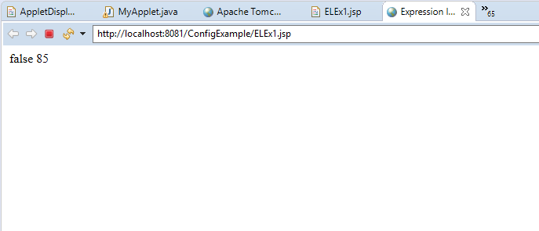
Expression Language Example Duration: 5 min
In this example we are evaluating the expressions with the help of EL.
ELEx1.jsp
<html>
<head>
<title>Expression language example1</title>
</head>
<body>
${5<2}
${13+29+43}
</body>
</html>
After running on browser we get following as output

Slide 5
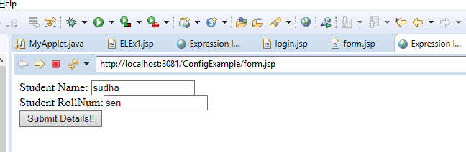
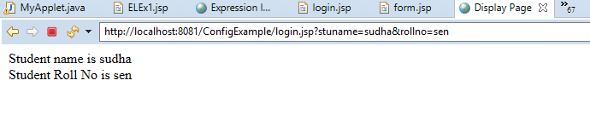
Expression Language Example Duration: 15 min
Fetching value using param variable of expression language
In this example we will prompt user to enter name and roll number. The other JSP page is fetching the entered details using param variable of EL.
form1.jsp
<html>
<head>
<title>Expression language example2</title>
</head>
<body>
<form action=“login.jsp">
Student Name: <input type="text" name="stuname" /><br>
Student RollNum:<input type="text" name="rollno" /><br>
<input type="submit" value="Submit Details!!"/>
</form>
</body>
</html>
After running on browser we get following as output
<html>
<head>
<title>Display Page</title>
</head>
<body>
Student name is ${ param.stuname } <br>
Student Roll No is ${ param.rollno }
</body>
</html>

Slide 6
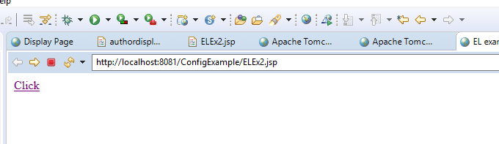
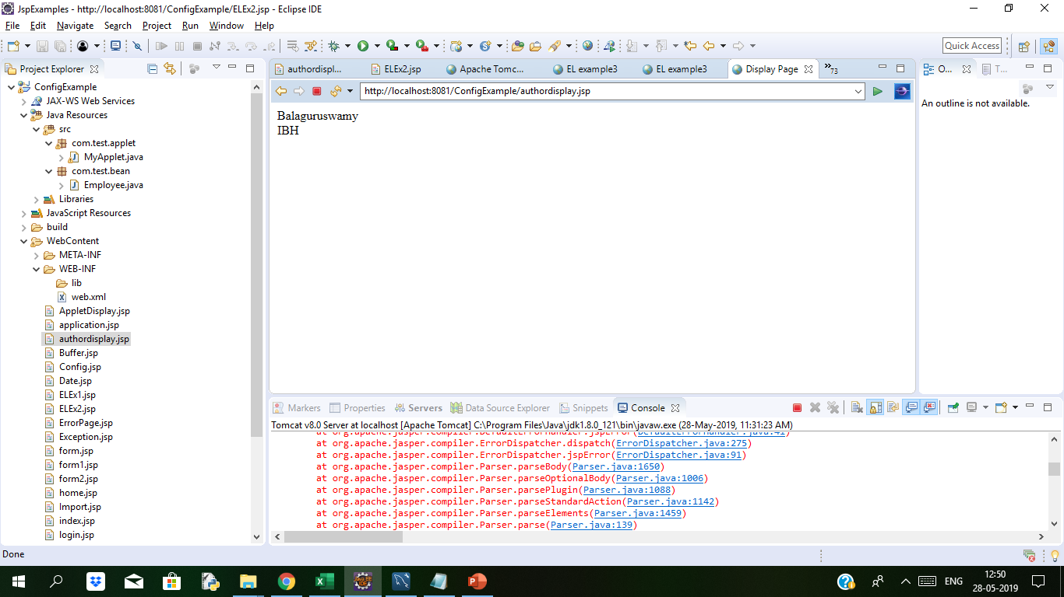
Expression Language Example Duration: 15 min
Getting values from application object.
In this example we have set the attributes using application implicit object and on the display page we have got those attributes using applicationScope of Expression language.
index.jsp
<html>
<head>
<title>EL example3</title>
</head>
<body>
<%
application.setAttribute("author", “Balaguruswamy");
application.setAttribute(“publisher", “IBH”);
%>
<a href=“authordisplay.jsp">Click</a>
</body>
</html>
We will see the below output
<html>
<head>
<title>Display Page</title>
</head>
<body>
${applicationScope.author}<br>
${applicationScope.publisher}
</body>
</html>

Slide 7
JSP EL Object
JSP EL Implicit Objects
JSP Expression Language provides many implicit objects that we can use to get attributes from different scopes and parameter values. The list is given below.
JSP EL IMPLICIT OBJECTS | TYPE | DESCRIPTION
pageScope | Map | A map that contains the attributes set with page scope.
requestScope | Map | Used to get the attribute value with request scope.
sessionScope | Map | Used to get the attribute value with session scope.
applicationScope | Map | Used to get the attributes value from application scope.
param | Map | Used to get the request parameter value, returns a single value
paramValues | Map | Used to get the request param values in an array, useful when request parameter contain multiple values.
header | Map | Used to get request header information.
headerValues | Map | Used to get header values in an array.
cookie | Map | Used to get the cookie value in the JSP
initParam | Map | Used to get the context init params, we can’t use it for servlet init params
pageContext | pageContext | Same as JSP implicit pageContext object, used to get the request, session references etc. example usage is getting request HTTP Method name.
Notes:
Note that these implicit objects are different from JSP implicit objects and can be used only with JSP EL.

Slide 8
JSP EL Object
JSP Expression Language – JSP EL Operators
Let’s understand at EL Operators and understand how they are interpreted and how to use them.
1.ELProperty Access Operator or Dot (.) Operator
JSP EL Dot operator is used to get the attribute values.
${firstObj.secondObj}
In the above expression, firstObj can be EL implicit object or an attribute in page, request, session or application scope. For example,
${requestScope.employee.address}
Note that except the last part of the EL, all the objects should be either Map or Java Bean, so in above example, requestScope is a Map and employee should be a Java Bean or Map. If the scope is not provided, the JSP EL looks into page, request, session and application scope to find the named attribute.

Slide 9
JSP EL Object
2. JSP EL [] Operator or Collection Access Operator
The [] operator is more powerful than the dot operator. We can use it to get data from List and Array too.
Some examples;
${myList[1]} and ${myList[“1”]} are same, we can provide List or Array index as String literal also.
${myMap[expr]} – if the parameter inside [] is not String, it’s evaluated as an EL.
${myMap[myList[1]]} – [] can be nested.
${requestScope[“foo.bar”]} – we can’t use dot operator when attribute names have dots.
3. JSP EL Arithmetic Operators
Arithmetic operators are provided for simple calculations in EL expressions. They are +, -, *, / or div, % or mod.
4. JSP EL Logical Operators
They are && (and), || (or) and ! (not).
5. JSP EL Relational Operators
They are == (eq), != (ne), < (lt), > (gt), <= (le) and >= (ge).

Slide 10
JSP EL Object
JSP Expression Language – JSP EL Operator Precedence
JSP EL expressions are evaluated from left to right. JSP EL Operator precedence is listed in below table from highest to lowest.
JSP EL OPERATOR PRECEDENCE FROM HIGHEST TO LOWEST
[ ] .
() – Used to change the precedence of operators.
– (unary) not ! empty
* / div % mod
+ – (binary)
< > <= >= lt gt le ge
== != eq ne
&& and
|| or
? :

Slide 11
JSP EL Object
JSP Expression Language – JSP EL Reserve Words
AND | OR | NOT | EQ | NE
lt | gt | le | ge | true
false | null | instanceof | empty | div,mod
Above are the reserved words, don’t use them as an identifier in JSPs.

Slide 12
JSP EL Object
JSP Expression Language Important Points
EL expressions are always within curly braces prefixed with $ sign, for example ${expr}
We can disable EL expression in JSP by setting JSP page directive isELIgnored attribute value to TRUE.
JSP EL can be used to get attributes, header, cookies, init params etc, but we can’t set the values.
JSP EL implicit objects are different from JSP implicit objects except pageContext, don’t get confused.
JSP EL pageContext implicit object is provided to get additional properties from request, response etc, for example getting HTTP request method.
JSP EL is NULL friendly, if given attribute is not found or expression returns null, it doesn’t throw any exception. For arithmetic operations, EL treats null as 0 and for logical operations, EL treats null as false.
The [] operator is more powerful than dot operator because we can access list and array data too, it can be nested and argument to [] is evaluated when it’s not string literal.
If you are using Tomcat, the EL expressions are evaluated using org.apache.jasper.runtime.PageContextImpl.proprietaryEvaluate() method.
We can use EL functions to call method from a java class, more on this in custom tags post in near future.

Slide 13
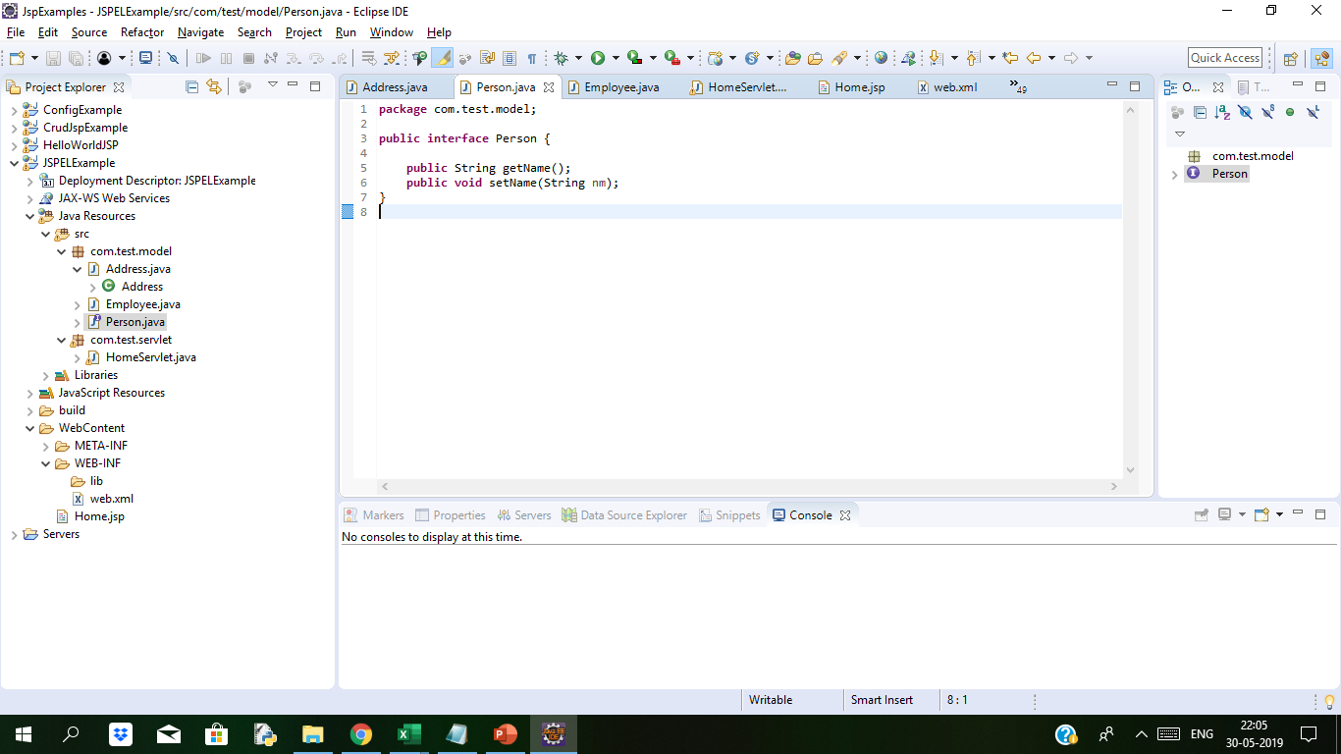
JSP EL Example Duration:20 min
We sill see EL usage with a simple application. We will set some attributes in different scopes and use EL to retrieve them and show in JSP page. Our project structure will be like below image.

Slide 14
JSP EL Example contd…
We have defined some model classes that we will use – Person interface, Employee implementing
Person and Address used in Employee.
Address.java
package com.test.model;
public class Address {
private String address;
public Address() {
}
public String getAddress() {
return address;
}
public void setAddress(String address)
{
this.address = address;
}
public String toString(){
return "Address="+address;
}
}
Employee.java
package com.test.model;
public class Employee implements Person {
private String name;
private int id;
private Address address;
public Employee() {
}
@Override
public String getName() {
return this.name;
}
@Override
public void setName(String nm) {
this.name = nm;
}
public int getId() {
return id;
}
public void setId(int id) {
this.id = id;
}
public Address getAddress() {
return address;
}
public void setAddress(Address address) {
this.address = address;
}
@Override
public String toString(){
return "ID="+id+",Name="+name+",Address="+address;
}
}

Slide 15
JSP EL Example contd…
Interface Person.java
package com.test.model;
public interface Person {
public String getName();
public void setName(String nm);
}}
Notice that Employee and Address are java beans with the no-args constructor and getter-setter methods for properties. I have also provided an implementation of toString() method that we will use in JSP page.
Now let’s see the code of a HomeServlet that will set some attributes.

Slide 16
JSP EL Example contd…
HomeServlet.java
package com.test.servlet;
import java.io.IOException;
import javax.servlet.ServletException;
import javax.servlet.annotation.WebServlet;
import javax.servlet.http.HttpServlet;
import javax.servlet.http.HttpServletRequest;
import javax.servlet.http.HttpServletResponse;
import java.io.IOException;
import javax.servlet.RequestDispatcher;
import javax.servlet.ServletException;
import javax.servlet.annotation.WebServlet;
import javax.servlet.http.Cookie;
import javax.servlet.http.HttpServlet;
import javax.servlet.http.HttpServletRequest;
import javax.servlet.http.HttpServletResponse;
import javax.servlet.http.HttpSession;
import com.test.model.Address;
import com.test.model.Employee;
import com.test.model.Person;
@WebServlet("/HomeServlet")
public class HomeServlet extends HttpServlet {
private static final long serialVersionUID = 1L;
protected void doGet(HttpServletRequest request, HttpServletResponse response) throws ServletException, IOException {
//Setting some attributes
Person person = new Employee();
person.setName("Nilesh");
request.setAttribute("person", person);
Employee emp = new Employee();
Address add = new Address();
add.setAddress("India");
emp.setAddress(add);
emp.setId(1);
emp.setName("Nilesh Rathi");
HttpSession session = request.getSession();
session.setAttribute("employee", emp);
response.addCookie(new Cookie("User.Cookie","Tomcat User"));
getServletContext().setAttribute("User.Cookie","Tomcat User");
RequestDispatcher rd = getServletContext().getRequestDispatcher("/Home.jsp");
rd.forward(request, response);
}
}

Slide 17
JSP EL Example contd…
Let’s define some context init params in the web.xml deployment descriptor.
<?xml version="1.0" encoding="UTF-8"?>
<web-app xmlns:xsi="http://www.w3.org/2001/XMLSchema-instance" xmlns="http://xmlns.jcp.org/xml/ns/javaee" xsi:schemaLocation="http://xmlns.jcp.org/xml/ns/javaee http://xmlns.jcp.org/xml/ns/javaee/web-app_3_1.xsd" id="WebApp_ID" version="3.1">
<display-name>JSPELExample</display-name>
<context-param>
<param-name>AppID</param-name>
<param-value>123</param-value>
</context-param>
</web-app>

Slide 18
JSP EL Example contd…
Home.jsp page with EL objects
<%@ page language="java" contentType="text/html; charset=US-ASCII"
pageEncoding="US-ASCII" import="java.util.*"%>
<!DOCTYPE html PUBLIC "-//W3C//DTD HTML 4.01 Transitional//EN" "http://www.w3.org/TR/html4/loose.dtd">
<html>
<head>
<meta http-equiv="Content-Type" content="text/html; charset=US-ASCII">
<title>JSP EL Example Home</title>
</head>
<body>
<% List<String> names = new ArrayList<String>();
names.add("Nilesh");names.add("Aman");
pageContext.setAttribute("names", names);
%>
<strong>Simple . EL Example:</strong> ${requestScope.person}
<br><br>
<strong>Simple . EL Example without scope:</strong> ${person}
<br><br>
<strong>Simple [] Example:</strong> ${applicationScope["User.Cookie"]}
<br><br>
<strong>Multiples . EL Example:</strong> ${sessionScope.employee.address.address}
<br><br>
<strong>List EL Example:</strong> ${names[1]}
<br><br>
<strong>Header information EL Example:</strong> ${header["Accept-Encoding"]}
<br><br>
<strong>Cookie EL Example:</strong> ${cookie["User.Cookie"].value}
<br><br>
<strong>pageContext EL Example:</strong> HTTP Method is ${pageContext.request.method}
<br><br>
<strong>Context param EL Example:</strong> ${initParam.AppID}
<br><br>
<strong>Arithmetic Operator EL Example:</strong> ${initParam.AppID + 200}
<br><br>
<strong>Relational Operator EL Example:</strong> ${initParam.AppID < 200}
<br><br>
<strong>Arithmetic Operator EL Example:</strong> ${initParam.AppID + 200}
<br><br>
</body>
</html>

Slide 19
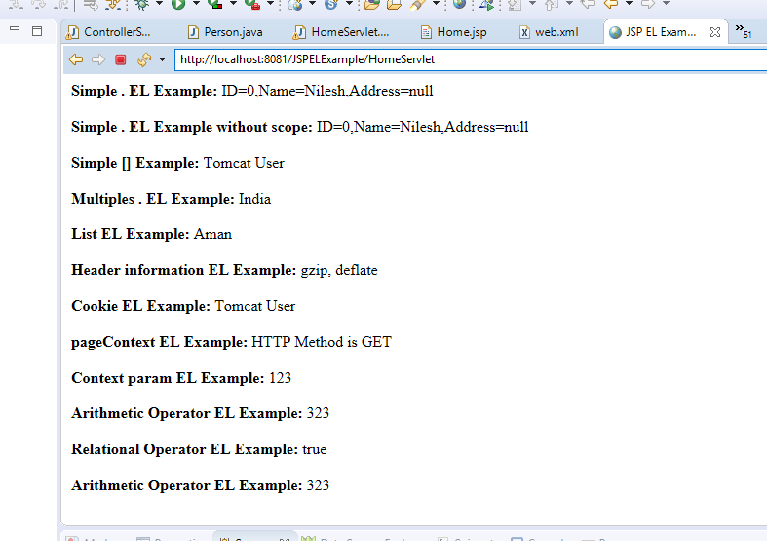
JSP EL Example contd…
After running the HomeServlet on browser we see the following screen

Slide 20

Thank You

